Slide 2
Mrs. Gina Solis
Kindergarten
Room 6
2022-2023

Slide 3
My Promise to You……..
I promise that each day your child will learn something new.
Some days it will come in their hands.
Some days it will come in their heads.
Some days it will come in their hearts.

Slide 4
Graduate of Cal Poly Pomona
8th Grade Language Arts Teacher
1st Grade Teacher
Intervention Teacher
Kindergarten Teacher
Mom and Wife
Eagle Canyon Community Member for 17 years

Slide 5
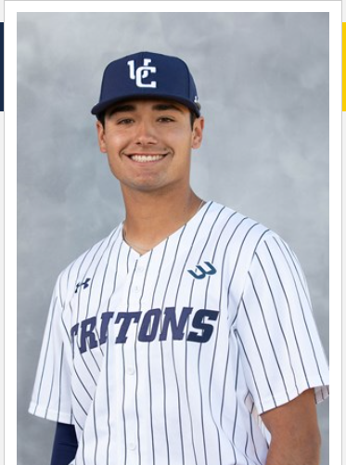
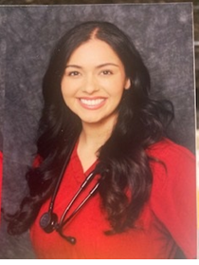
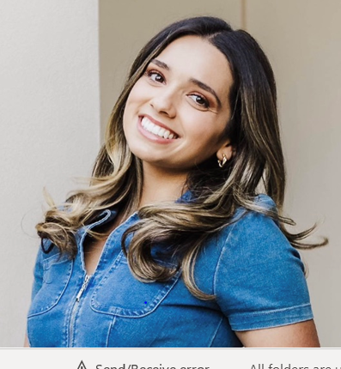

Slide 6
Room 6 represents the Oregon Ducks

Slide 7
Early Bird/Late Bird Schedule
7:50 – 11:10 Early Bird
9:20 – 12:40 Late Bird
*Overlap 9:20 - 11:10

Slide 8
Wednesday Instruction
All Students are on the same schedule
7:50-11:10
*There will be additional minimum days throughout the school year. Please refer to the school’s master calendar and the flyer in your folder.

Slide 9
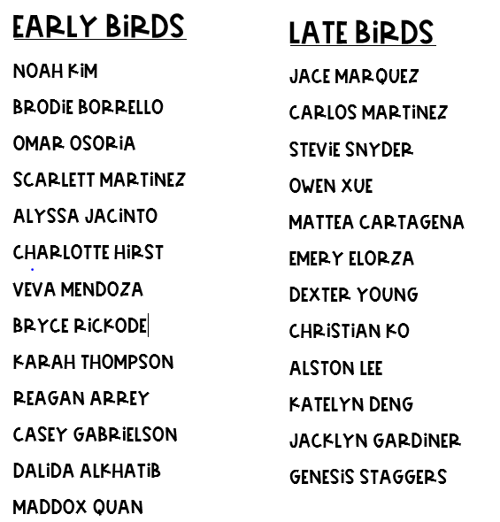
Early Birds/Late Birds

Slide 10
Early Birds School Arrival/Departure
Gates will open at 7:40
Students will enter through the Kindergarten Gate and walk directly down the hall. Students will always enter/exit through the back door. Students will be excused at 11:10. Please be on time as there will be no supervision after 11:15. Ms. Day will excuse the early birds. STudents will be taken to the school office after 11:15.

Slide 11
Late Birds School Arrival/Departure
Gates will opened at 9:20 and will only remain open for 5 minutes. If you arrive after the gate is closed, you will have to sign your child in through the office and they will be considered tardy, Students will always enter/exit through the back door. Students will be excused at 12:40. Students not picked up by 12:45 will be taken to the office.

Slide 12
Daily Schedule
7:50 - 8:00 Morning Warm Up Work
8:00 - 9:20 ELA/ELA Centers
9:20 - 9:40 Late Birds arrive/Morning Meeting
9:40 - 10:20 Math
10:20 – 10:40 Recess/Snack
10:40 - 11:10 Math Center/Soc Studies/Science
11:10 - 11:20 Early Birds Excused/Warm Up WOrk
11:20 – 12:40 ELA/ELA Centers
12:35- - 12:40 Late Birds Clean Up/Excused

Slide 13
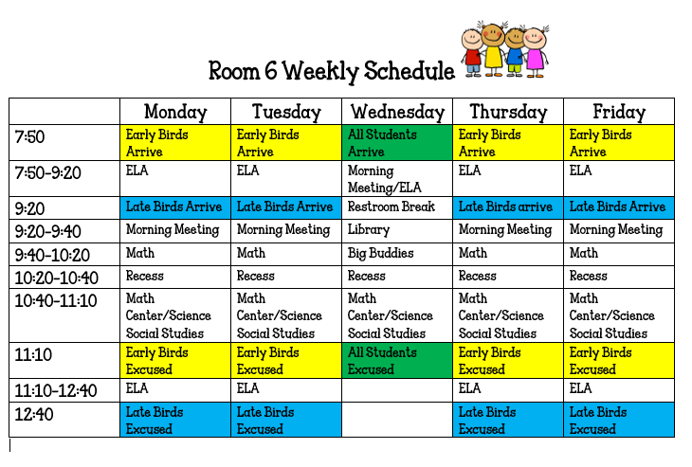

Slide 14
School/Classroom Policies

Slide 15
School Policies
Please refer to the Eagle Canyon Handbook online for school policies and procedures.
*All volunteers must check in at the front office using our Raptor system. Volunteers must show proof of being vaccinated or have a recent negative Covid test

Slide 16
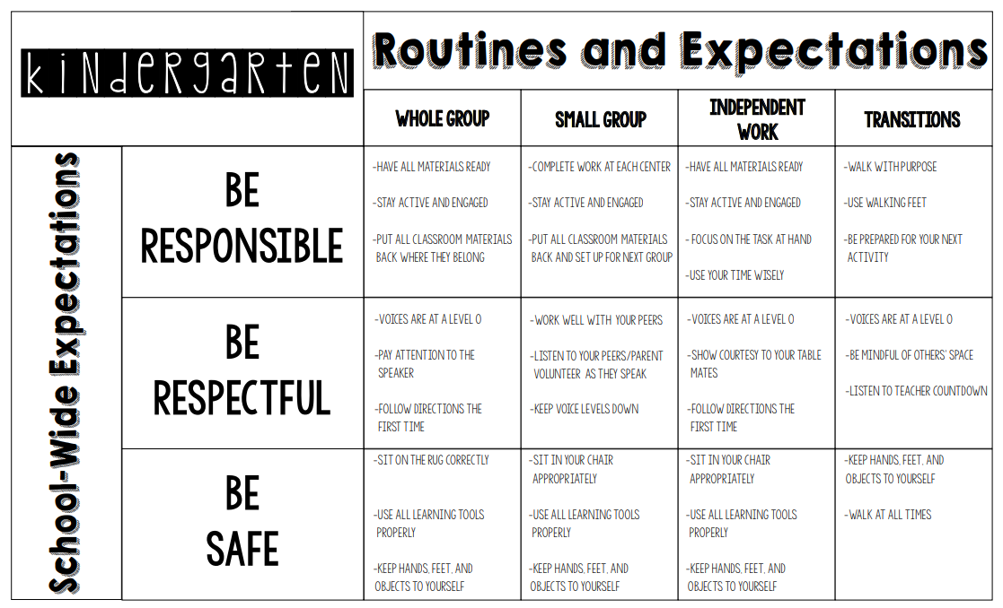
Kindergarten Expectations

Slide 17
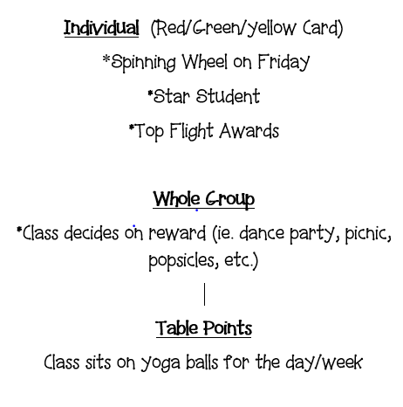
Room 6 Rewards

Slide 18
Room 6 Consequences
Warning - Green Card
2nd Warning - Yellow Card *2 Minute Calm Down
3rd Warning – Red Card *Loss of partial recess
*Call/Email home will take place if the students is consistently on the red card
*Students have the opportunity to earn their way back to the Green Card each day.

Slide 19
Grading Policy
For Kindergarten, your child will be assessed purely on their ability to master kindergarten standards throughout the year. Instead of traditional grading such as an A, B, C, etc., your child will be given a grade using a number scale based on 1-4.
The scale will go as follows:
1- Not meeting the standard
2- Progressing toward the standard 3- Meeting the standard
4- Exceeding the standard

Slide 20
Snack Procedures
Please send a in small snack, NO FULL LUNCHES, clearly marked with their name on it. If a lunch is needed for daycare, be sure your child knows which item is their school snack. NO LUNCH PAILS
Suggestions: fruit, yogurt, crackers.
*Water bottles need their name on them.

Slide 21
Homework Policy
Homework will consist of the following items from Monday thru Thursday;
~Packet work
~IXL
~DL Readers
~Sight Word Practice
~Reading Log (due at end of month)
*AR and Seesaw will begin later in the school year.

Slide 22
Homework Folders
Homework folders will be sent home on Mondays and need to be returned on Friday. The packet is designed to take about 30 mins a day. Please Do Not do it all in one day. Please be sure that ALL work is completed in their own writing.

Slide 23
Reading Log
A reading log will be sent home on a monthly basis. Please color in one item for every book that is read. Be sure to ask engaging questions and ask your child to point out the title, author, characters, settings, etc.

Slide 24
Friday Folders
Folders sent home on Fridays will include all of their work completed in class that week. Please go through your child’s corrected work and offer praise and encouragement. This folder may also contain communication from myself, the office or PTA about upcoming events. Please help your child learn responsibility by helping to take care of the
folder and remembering to return it on Monday

Slide 25
Online Platforms

Slide 26
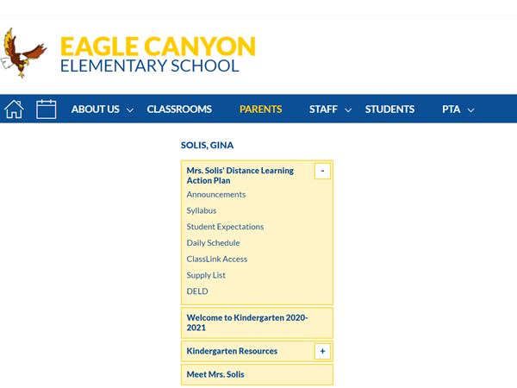
Eagle Canyon Website
Classlink and my class page can be accessed via the Eagle Canyon website,

Slide 27
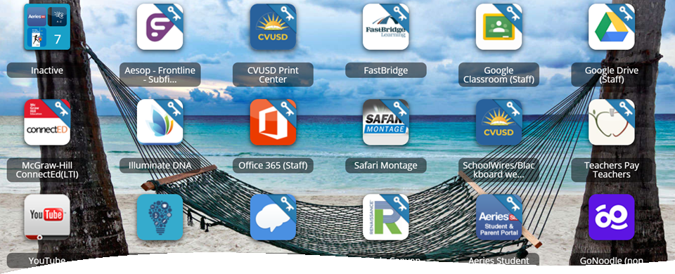
Classlink
Your child will be logging onto to their device via classlink. All online platforms used in class and at home will be accessed from CLasslink. The link is available on the Eagle Canyon Website

Slide 28
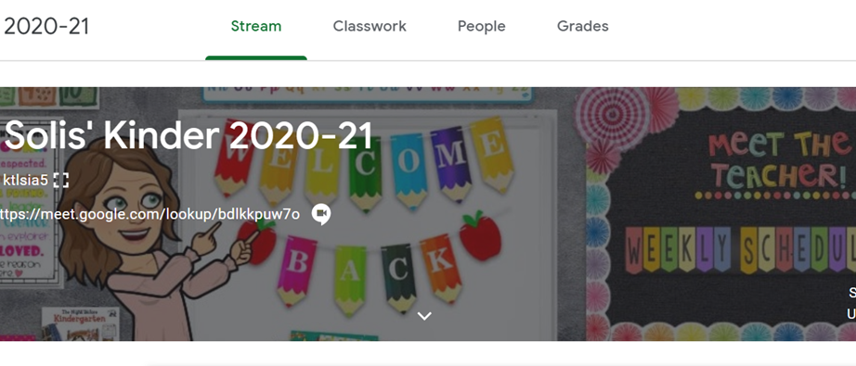
Google Classroom

Slide 29
Online Platforms
www.ixl.com
seesaw.link
Accelerated Reader

Slide 30
Online Platform
Your children will learn math at their own pace—IXL's adaptive questions automatically adjust to just the right level of difficulty. A wide variety of question types keeps practice sessions fresh and enables all types of learners to reach their full potential. IXL will be assigned daily and will support the math lessons taught in class. I am requesting that your child work on IXL for 10-15 minutes a day.

Slide 31
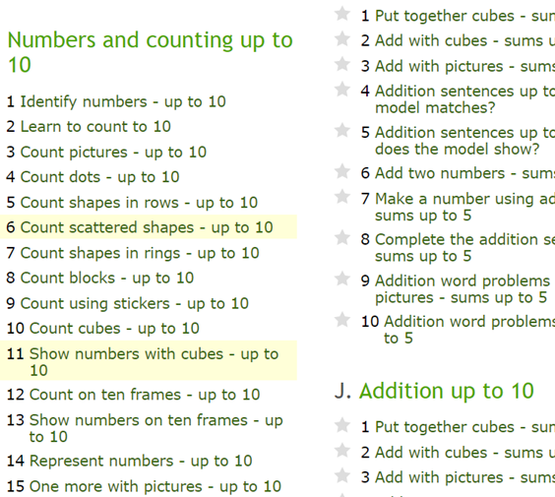
IXL Recommended Skills

Slide 32
Accelerated Reader
Once a student has mastered their 10 sets of sight words, they will have the opportunity to begin taking AR tests. They may either read a book with you or I will have live recordings posted on Seesaw. Accelerated Reader assesses their comprehension skills. They will access on their classlink and their username/password will be the same as their classlink one.

Slide 33
KIndergarten Curriculum

Slide 34
To view the Common Core standards in all subjects, please access the following link;
http://www.teachingfirst.net/standardskinder.htm
We will be focusing on the 10 identified essential standards for both Math and ELA.

Slide 35
Language Arts
Sight Words
Dynamic Literacy Readers
Writing
Phonics Instruction
Reading Comprehension

Slide 36
Sight WOrds
Sight words will be tested weekly. I will let you know which day of the week it will take place on. Please practice these on a daily basis.

Slide 37
Dynamic Literacy Readers
Phonics books will be sent home when a student knows all of their sounds. Books will be sent home on Mondays and should be returned on Friday when they will be tested. If read fluently they will receive the next one on Monday.

Slide 38
Writing
Through drawing, dictating and writing , your child will be asked to write on three different topics..
*An opinion *An informative *A narrative
In order to meet the standard they will have to write 3-4 sentences on their own by the end of the school year. Writing should inlcude capital letters, punctuaiton and phonetically spelled words.

Slide 39
Phonics Instruction
I will be introducing new letter names and sounds 3-4 times a week. Please be sure to reinforce the introduced letter in your daily activities with suggested recommended activities…
*I Spy the letter/sound
*Hopscotch w/ letter/sound
*Words that begin with…..
*Scavenger Hunt with letter
*Rhymes with…
*Letter Bingo

Slide 40
Math
*One to one correspondence
*Mathematical reasoning
*Count from 1-100 (by ones, tens and fives)
*Concepts of equality, more and less
*Write numbers to 30
*Place Value
*Add and subtract to 10
*Identify shapes (planes and solids) 2D & 3D
*Measurement

Slide 41
Estimation Jar
Your child will be given the “Estimation Jar” for a weekend. Please help him/her choose a number of small items that will fit in the jar—all of the items must be the same kind, ex. all beads, all pencils, candies, etc. Have your child count exactly how many items are in it. Please no more than 50 items until Dec and no more than 100 items after Dec.

Slide 42
Science/Social Studies
Science and social studies will be integrated through our language arts program. We will implemeniting a new science curriculum. We woll also be doing many STEM project based learning activities throughout the year.

Slide 43
Classroom Procedures

Slide 44
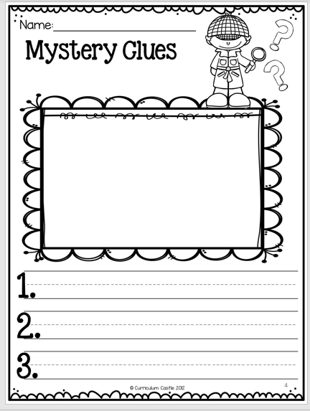
Sharing
.
Sharing will change will throughut the school year. Please refer to the Monday newsletter for weekly updates. Each child will share twice a month. One will be their family project and the other will change monthly.

Slide 45
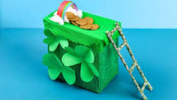
Family Projects
.
There will be a family project sent home at the beginning of each month. Along with your family members, please help your child complete the project.

Slide 46
Book Orders
An order form from Scholastic will be sent home bi-monthly. Forms will be in the Homework folders. Orders can be placed online using our class code or brought into the teacher. Please make checks payable to Scholastic Books

Slide 47
Meet Mags….
Mags is our class pet and will spend a weekend at your home sometime during the school year. Please include him in your daily lives and ask your child to write about the experience in the included journal. They will have an opportunity to share with the class on Monday morning.

Slide 48
Student of the Week
Each week of the school year a child is randomly chosen to be the Star of the Week. This child is highlighted with an info poster and pictures.

Slide 49
Birthdays
.If you would like to celebrate your child’s birthday with the class, please make arrangements with me prior to their day. I will be celebrating summer birthdays at the end of the school year.

Slide 50
Miscellaneous Information

Slide 51
School Supply List
Students will need the following items AT HOME in order to complete their homework;
crayons
Pencils
Scissors
Glue
Manipulatives (pennies, uncooked beans, etc)
* I will periodically request classroom supplies via the newsletter or Classtag

Slide 52
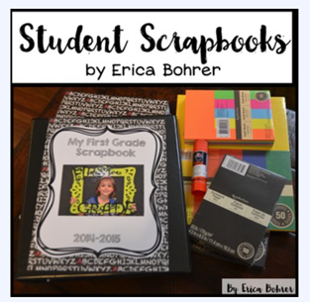
Student Scrapbooks
Students will be creating a Kindergarten Scrapbook that they will keep at the end of the school year. Please refer to the memo in your folder.

Slide 53
Teacher Wish List
My wishlist will be posted on Classtag. All contributions are greatly appreciated.

Slide 54
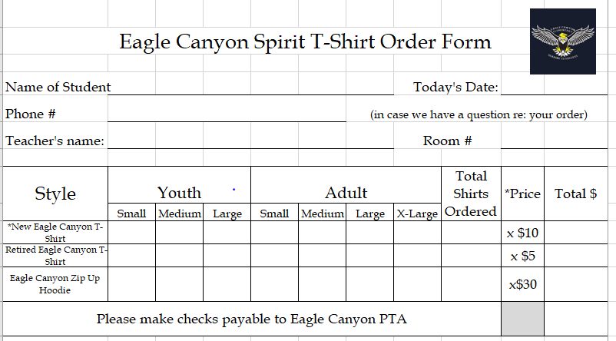
Spirit Wear

Slide 55
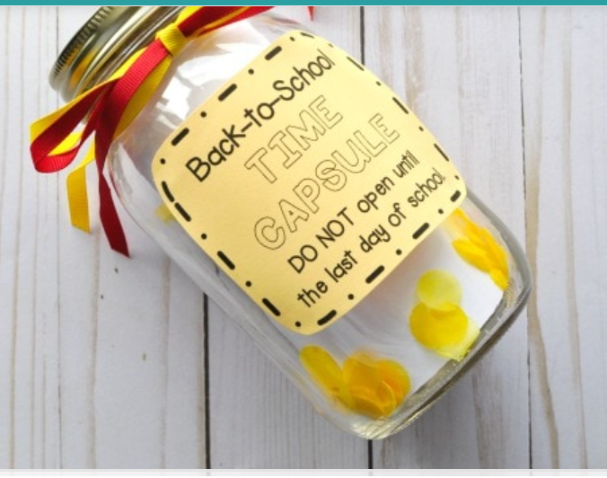
Time Capsule
Please participate by completing the morning and afternoon questionnaire and return it to school the following day. Thank you!

Slide 56
The Parent’s Role

Slide 57
Parent Responsibilities
*Give yourself Grace
*Establish routines and expectations at home
*Set a schedule that works for you and your child
*Weave choice into your child’s school day
*Encourage physical activity
*Establish times for quiet and reflection
*Have children help with household responsibilities
*Be sure to contact me with specific concerns/questions
*Read, Read, Read!
*Trust that learning happens EVERYWHERE

Slide 58
Parent Volunteers Needed
Room Parent Assistants (organizes parties and special events)
Scrapbook Reps (designs and prepares pages for scrapbooks)
Class Photographer (takes pics of all special events)
Room 6 Circus Coordinator (Organizes backdrops and costumes)
Additional Help Needed
*making copies
*prepping materials at home (cutting out, gluing, etc)
*working in the classroom with centers
*sight word or DL literacy book testing (preferably Fridays)
*reading to the class

Slide 59
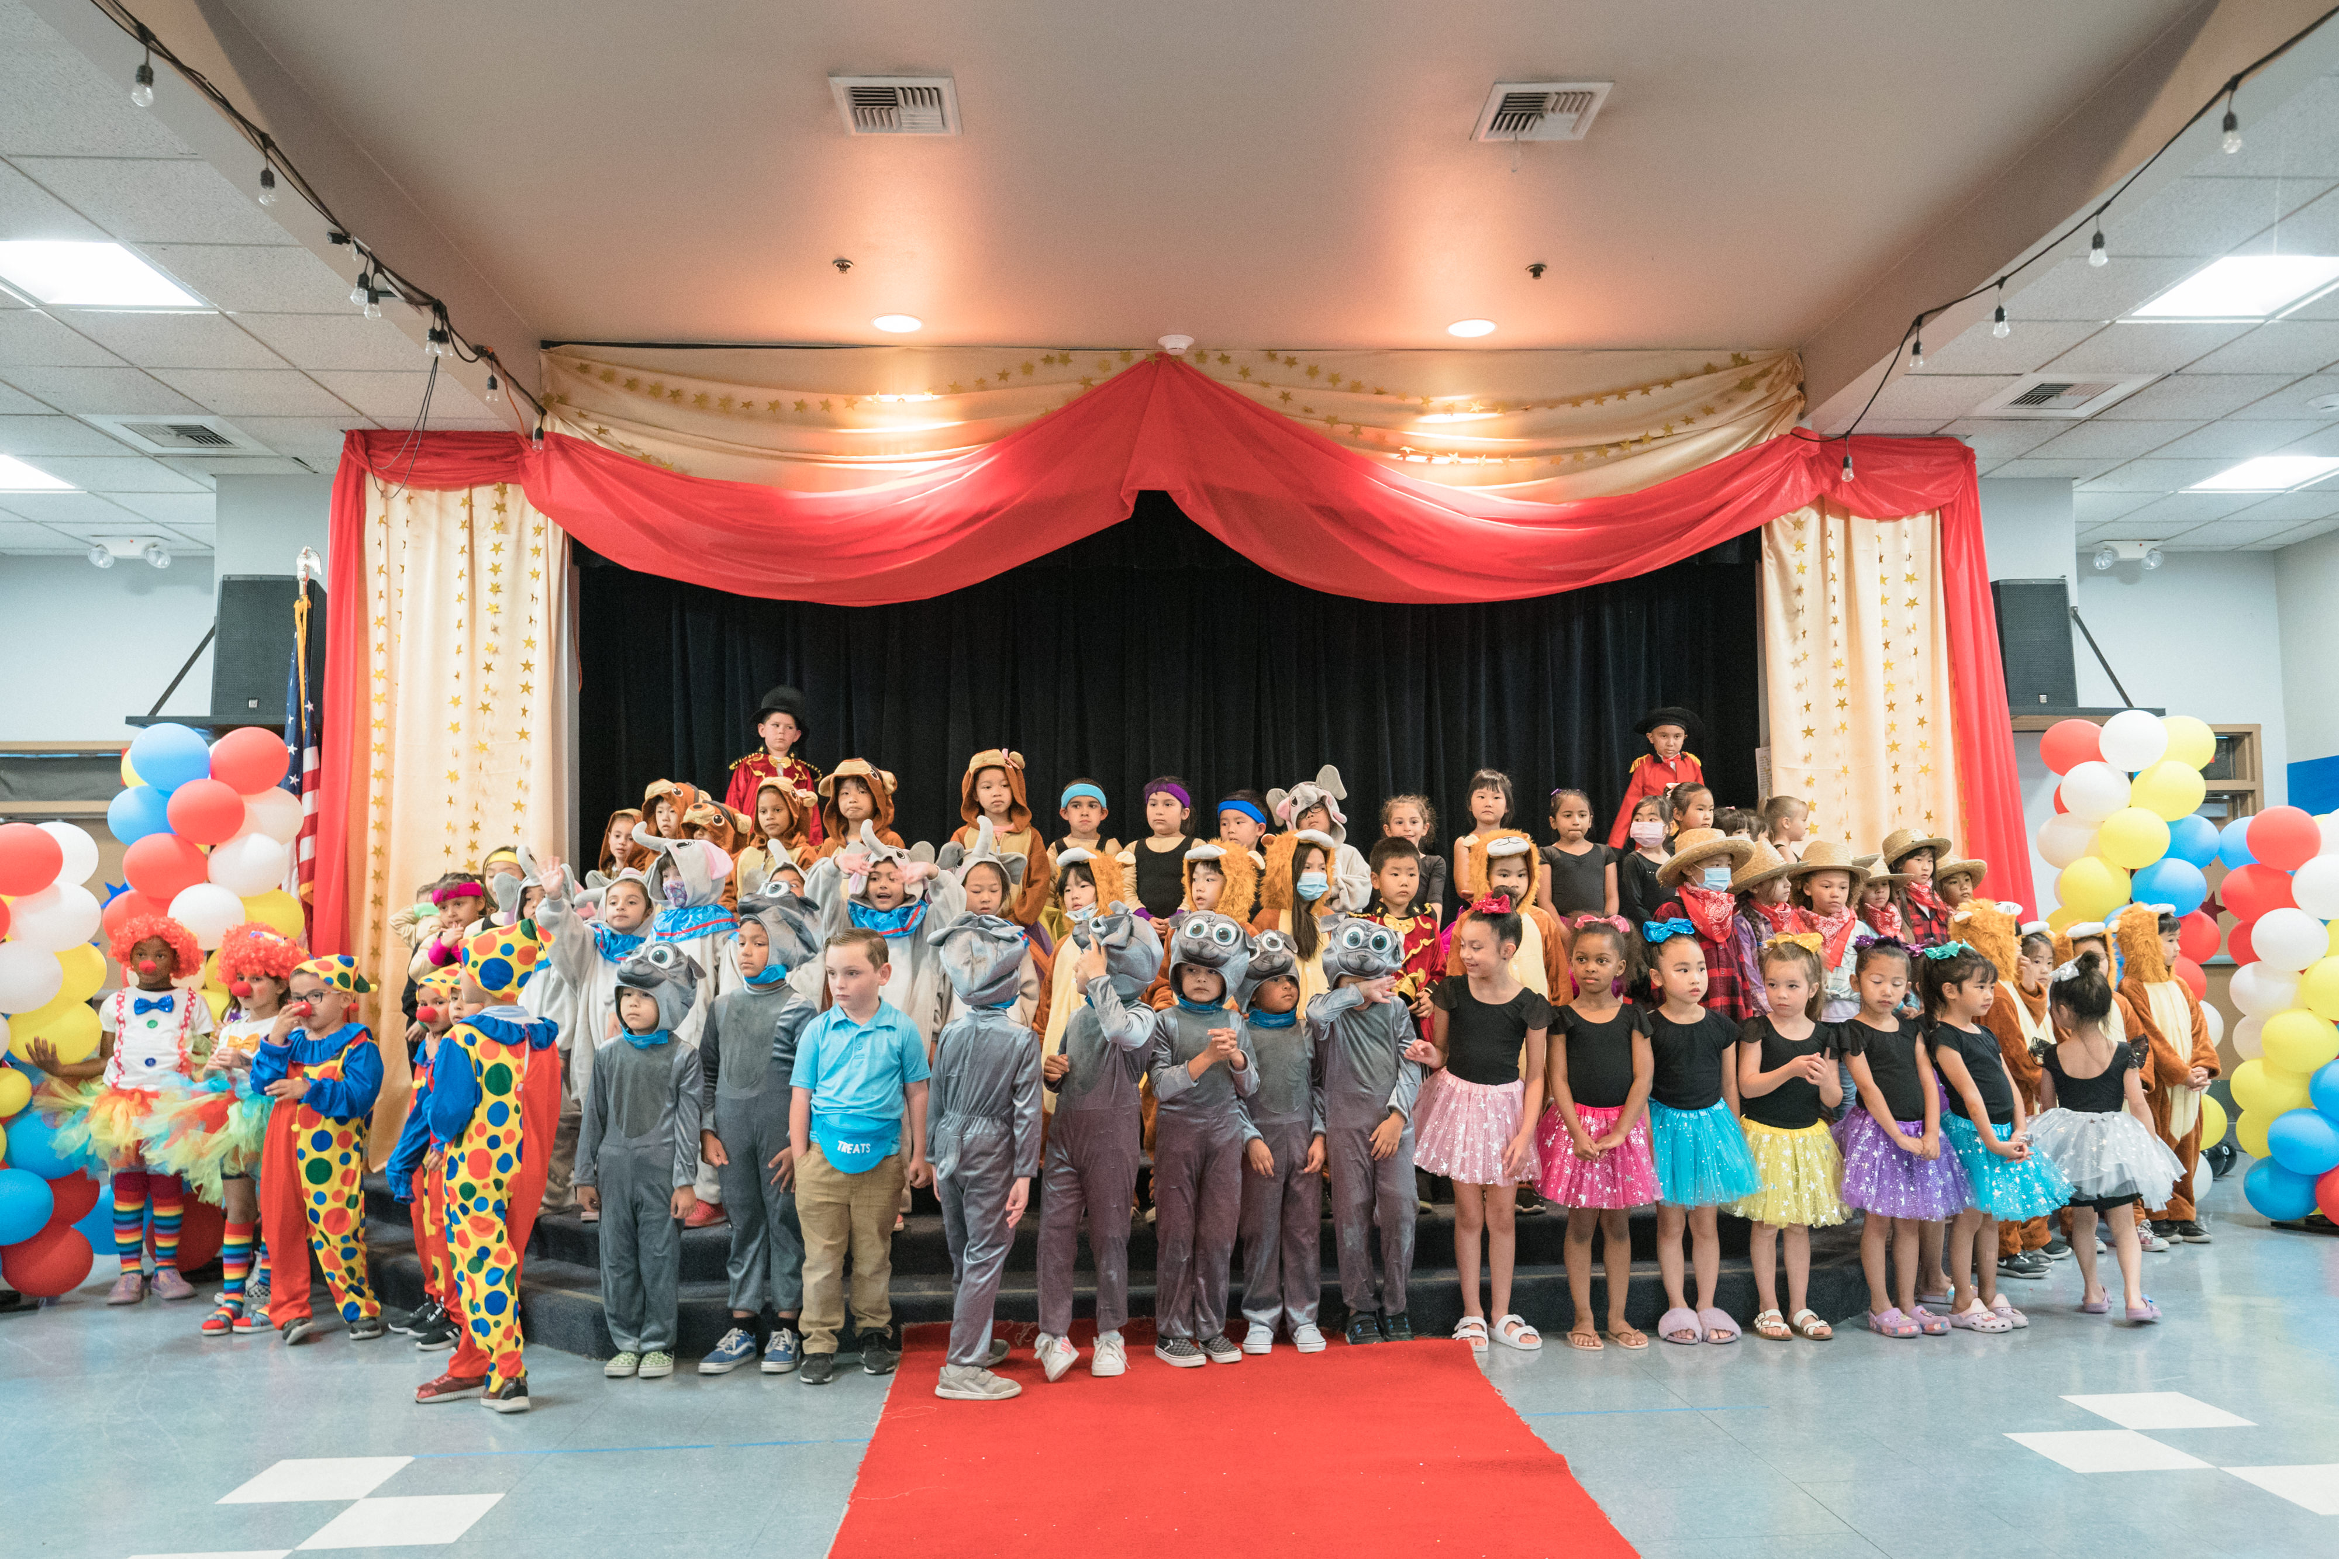
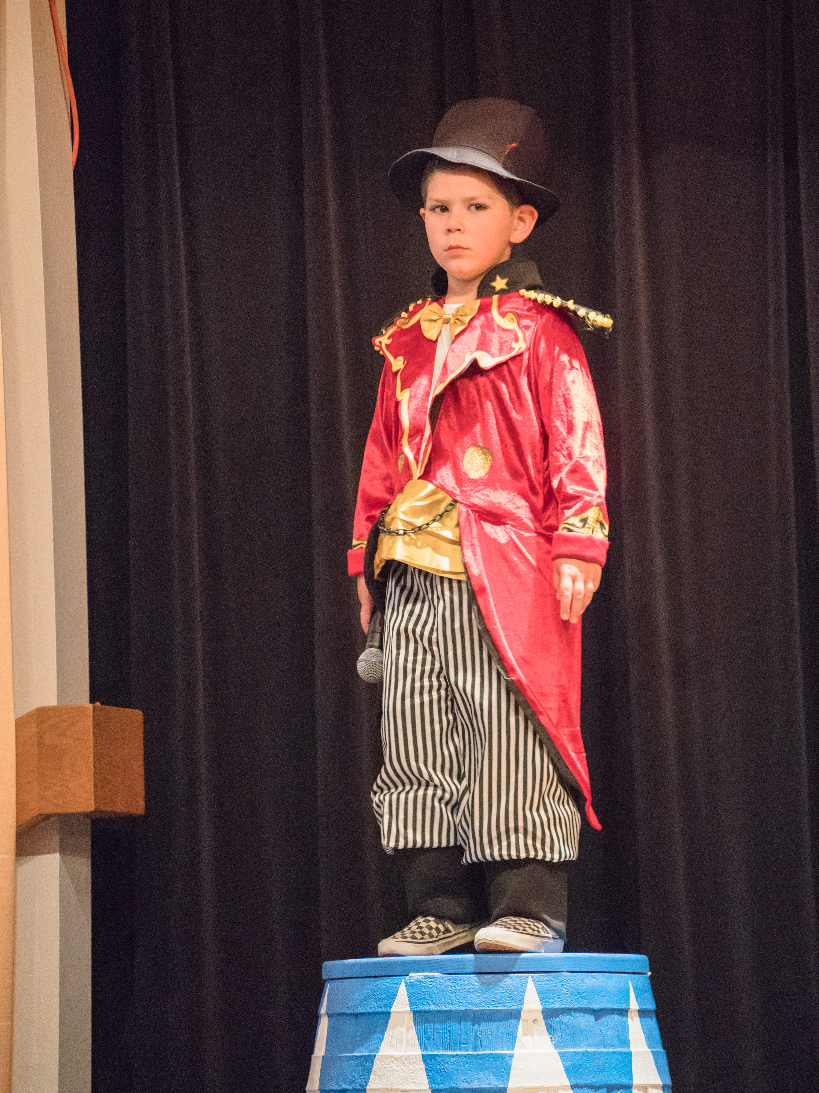
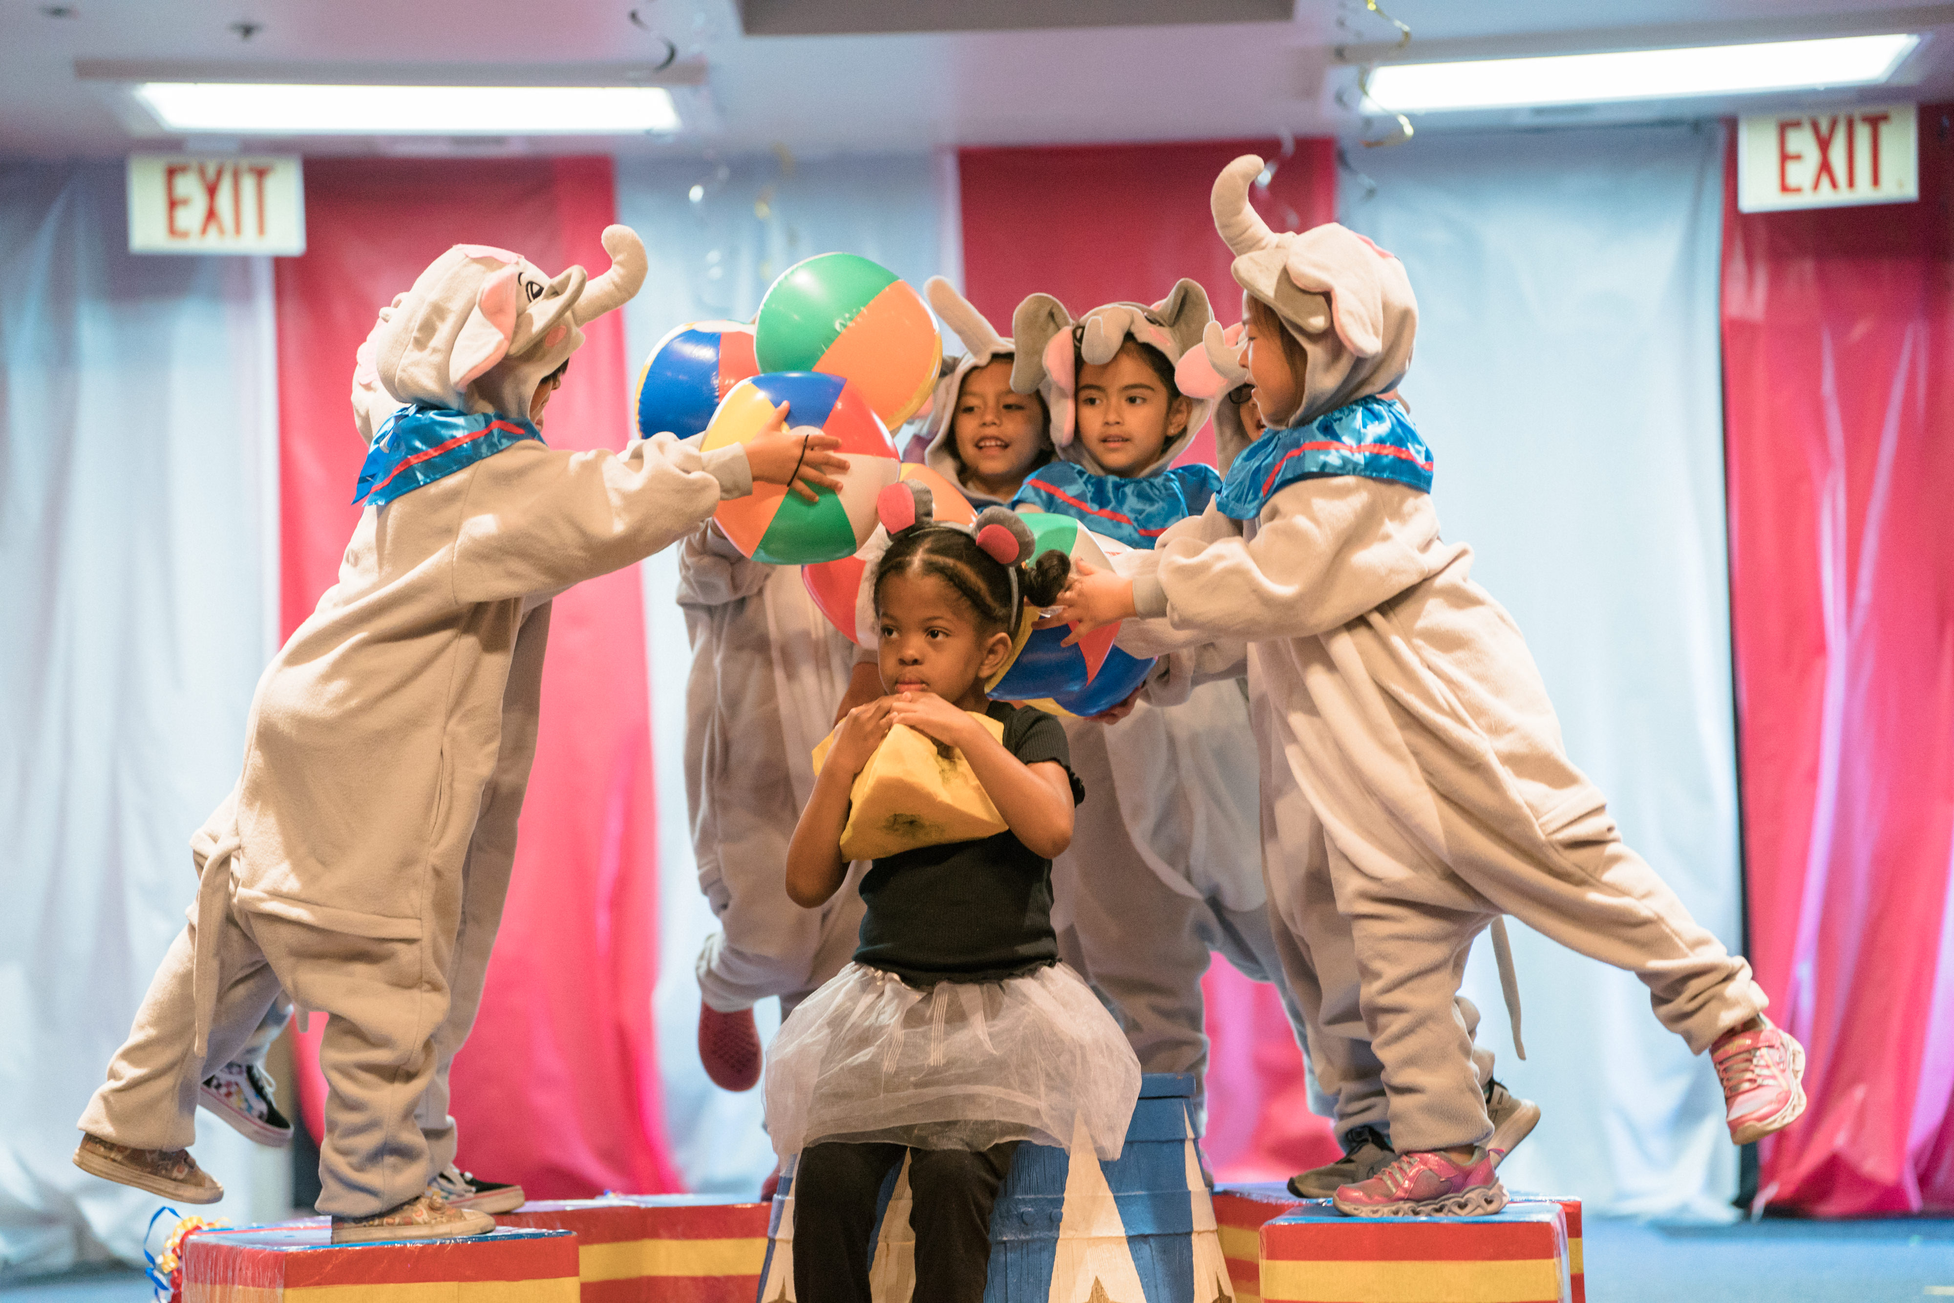
Parent Volunteers Needed
Come One, Come All…. to the
Greatest Show on Earth!!
Lions, Dogs, Clowns, Elephants, Announcers, Cowboys, Cowgirls, Tightrope Walkers, Acrobats, Bears, and Stongmen/women

Slide 60
PTA Membership

Slide 61
Communication

Slide 62
Classtag
All Communication will be sent home via Classtag. Classroom updates, special events, sight word testing, conferences, pictures and reminders will be sent via the Classtag app.

Slide 63
Aeries

Slide 64
Contact Info
I will respond to all emails/classtag messages within a 24 hour time period. If you need to get ahold of me immediately, please call the school office at (909)590-2707.
Gina_solis@chino.k12.ca.us
Classtag

Slide 65
Mark your Calendars
*Meet Your Teacher – tomorrow 8:30 – 9:30
*The Night Before Kindergarten – Please share the video with your child on Sunday evening

Slide 66
Thank YOU for attending our Kindergarten Back to School Night. I look forward to sharing in your child’s educational journey. you.

